Slide 1

SUBMITTED BY:-
SUBMITTED TO :-
Mr. Mayank Saxena Technical Trainer
Vasuraj Yadav (201500777)
Umang Sharma (201500753)
Vishal Dixit (201500792)
UV Square Property Group
Website

Slide 2

Introduction
Table of Contents
I
II
Software and Hardware Requirements
III
Snapshots
IV
Github Link

Slide 3

I Introduction

Slide 4
I Introduction
Real Estate Management System is an all-in-one web based Real Estate Software CRM to fulfill your property management. The Research synopsis is the plan for your research project. All the employees can work on single software which maintains construction details, property details, payroll and many more. This document provides guidelines for preparing a research. The main objective of this project is to bring the real estate industry online and enabling real estate industry participants to benefit from the Internet.
Site acts as an interface between Individuals, brokers and realtors.
Here the user can advertise his property for buying or for selling. Site provides online real- estate service committed to helping you make wise and profitable decisions related to buying, selling, renting and leasing of properties in India.

Slide 5

II Software & Hardware Requirements

Slide 6


II Software Requirements
VS Code
HTML
CSS
JavaScript
Firebase Authentication

Slide 7


II Hardware Requirements
4GB ram Window 10 / 11

Slide 8
III Snapshots

Slide 9
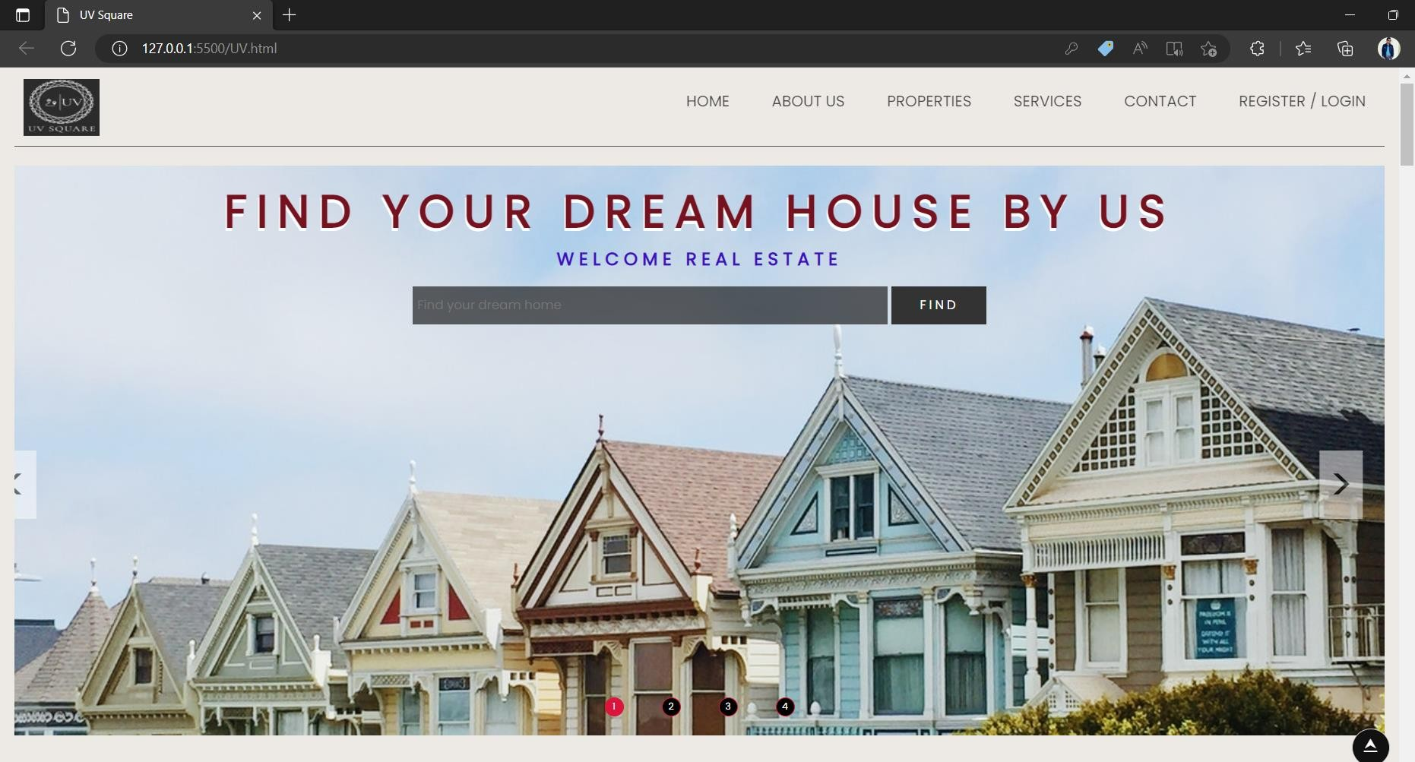
III Home page

Slide 10
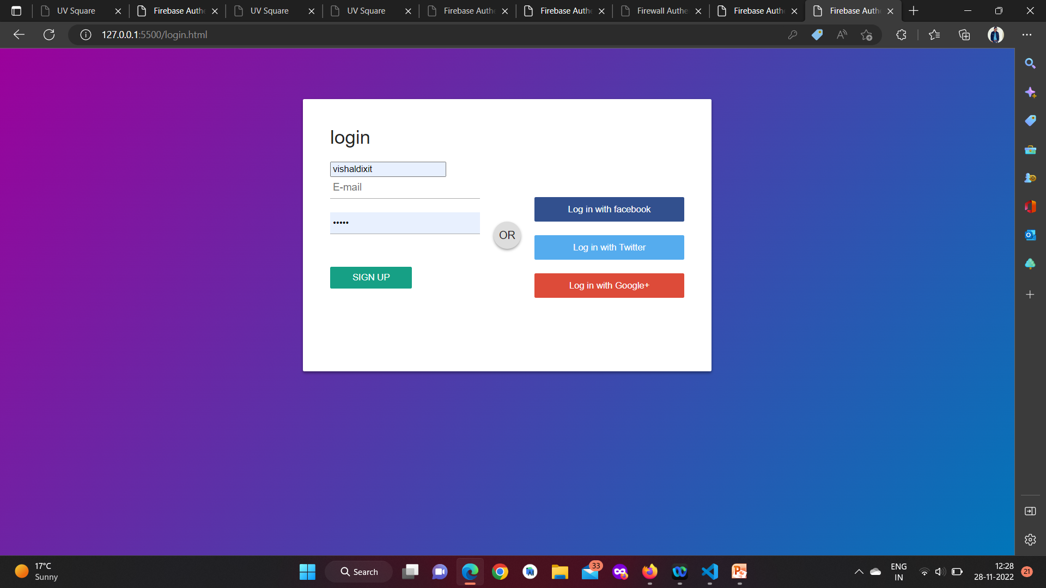
III Login page

Slide 11
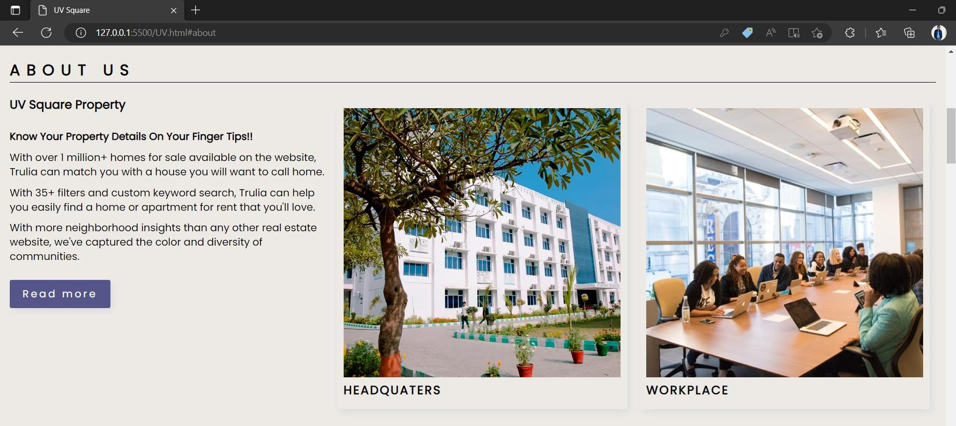
III About Us page

Slide 12
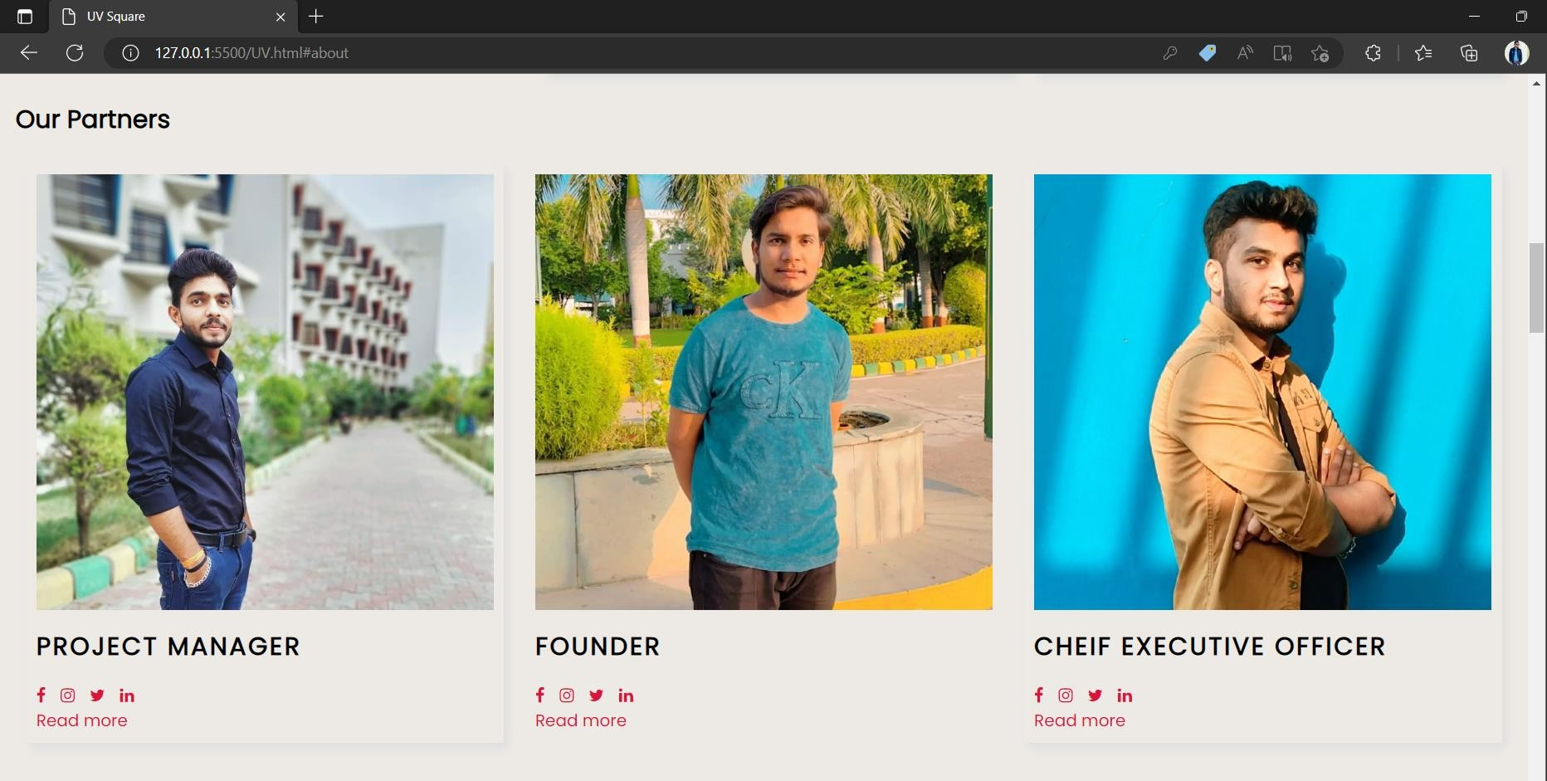
III Our Partners page

Slide 13
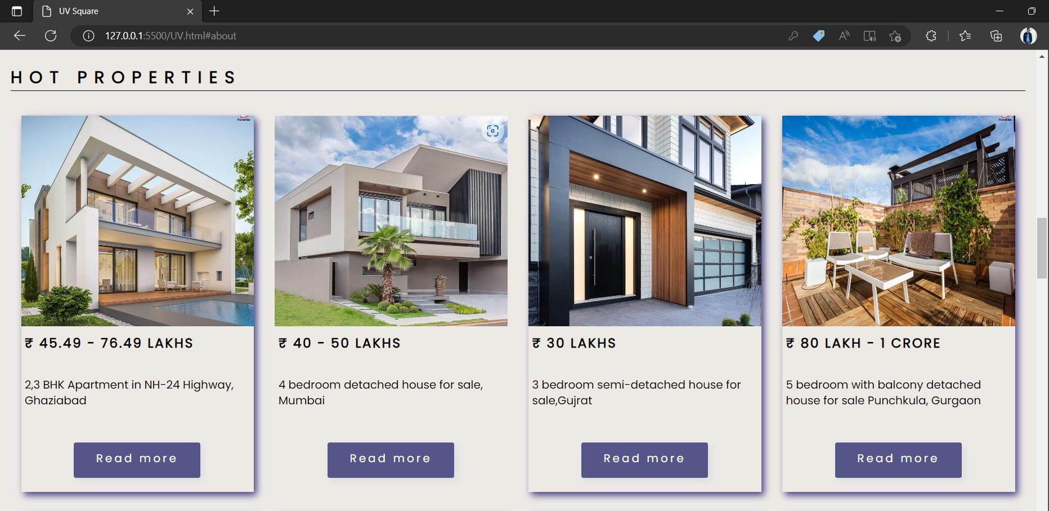
III Properties page

Slide 14
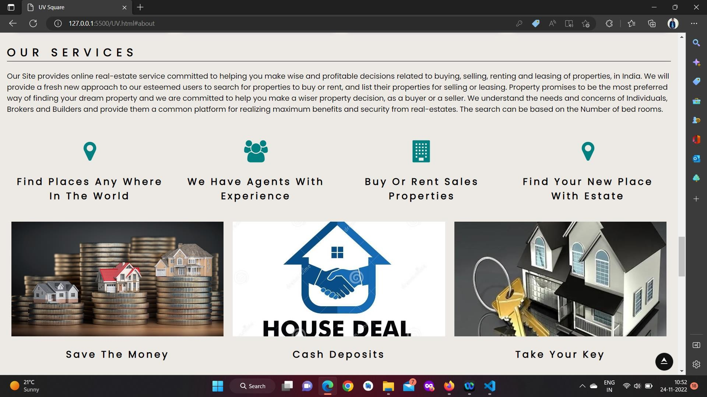
III Services Page

Slide 15
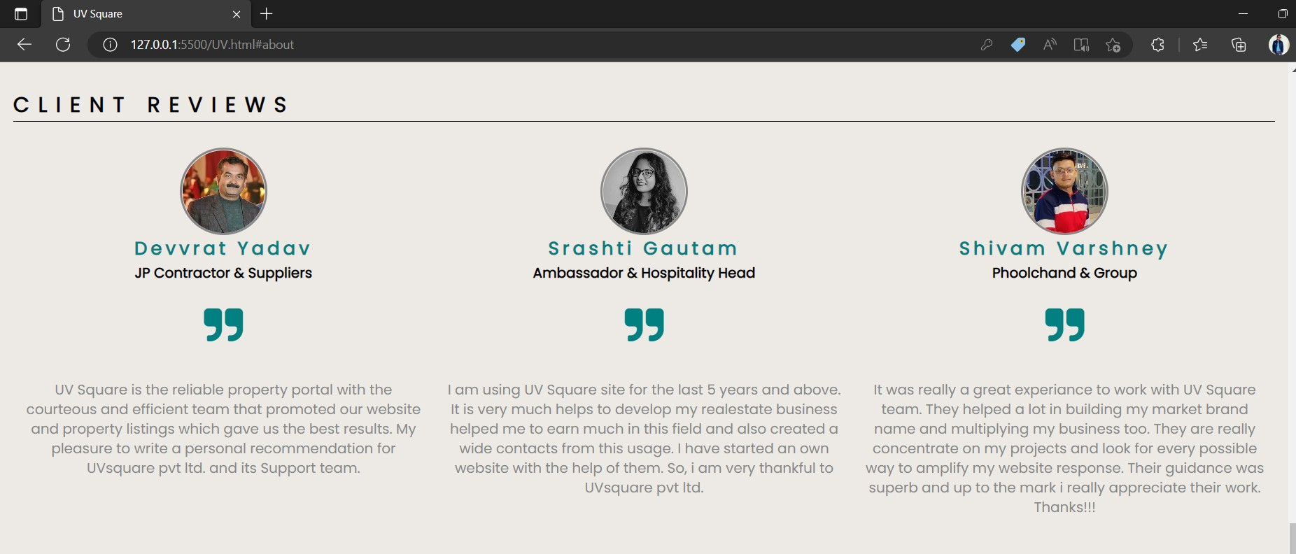
III Client Review Page

Slide 16
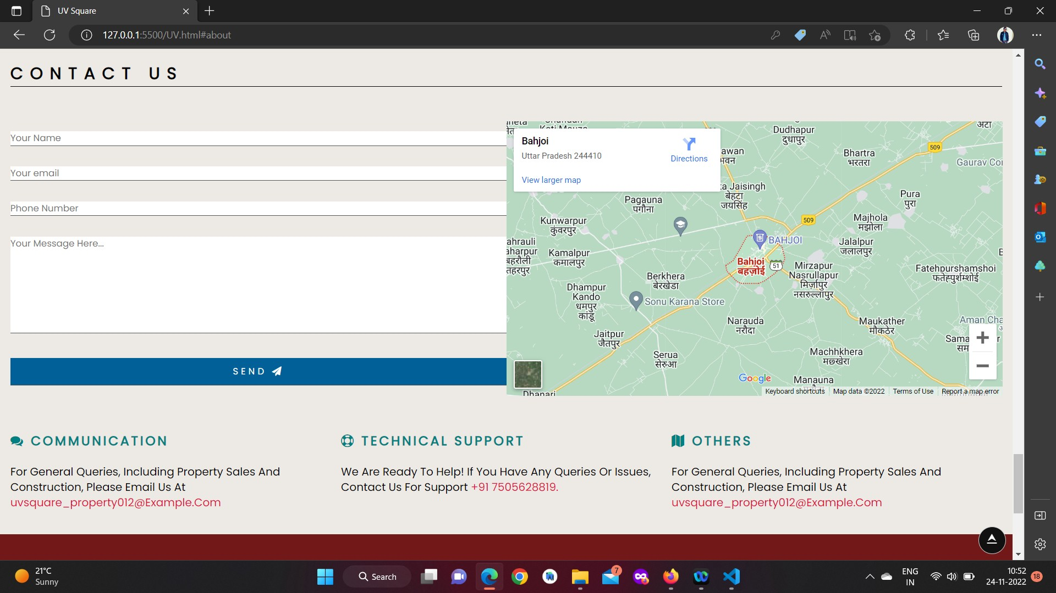
III Contact Us

Slide 17
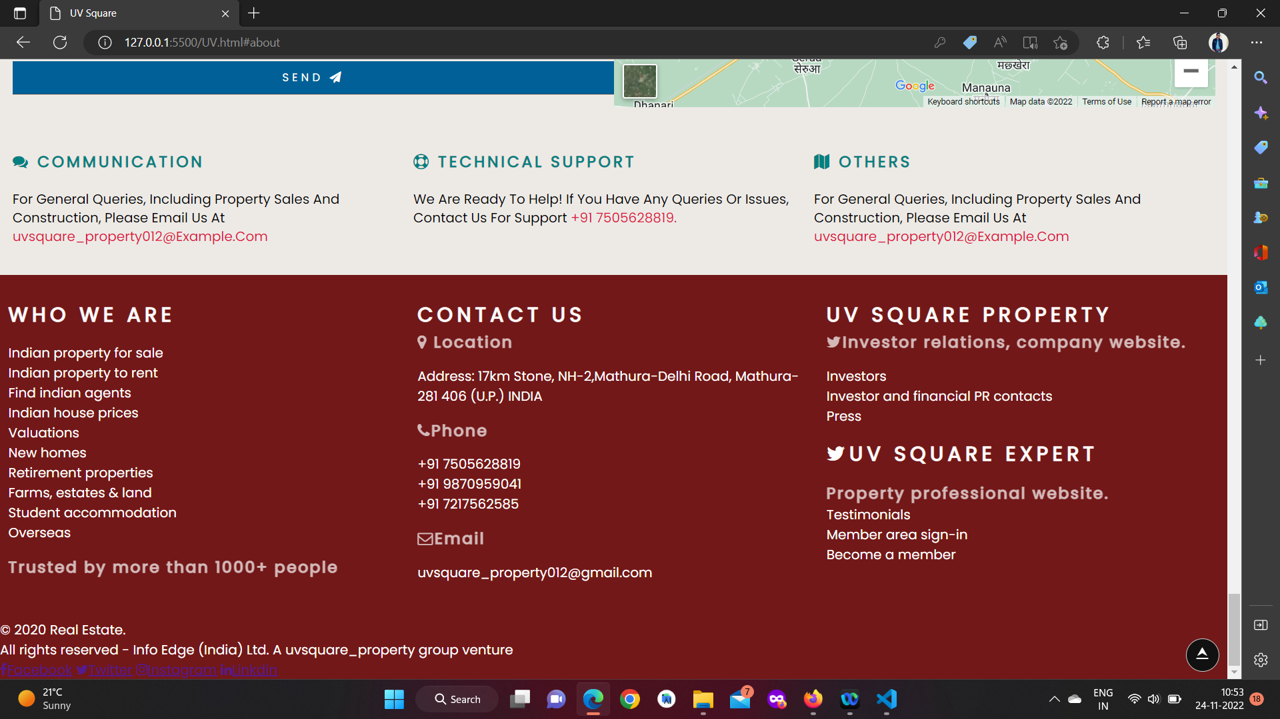
III Footer

Slide 18
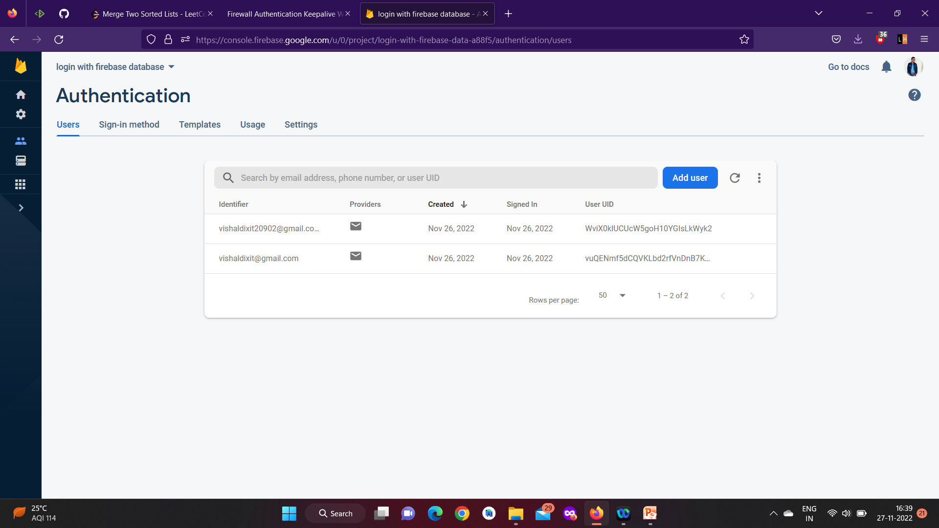
III Firebase Authentication

Slide 19
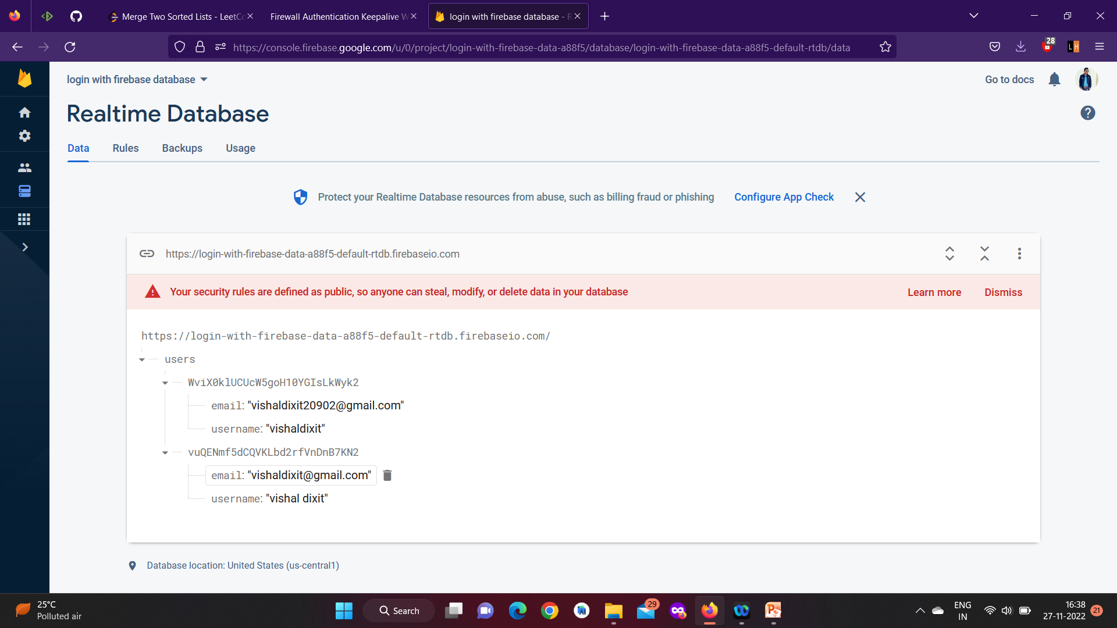
III Realtime Database

Slide 20
IV Github link
https://vishaldixit8819.github.io/Mini_project_UV_Square/

Slide 21
Thank you!

